Slide 1
Ed 555 Teacher As Researcher

Slide 2
Notes:
Four arrows.
Well, this is something quite different if you graduated from University of Michigan.
Notice how you can see the arrows or see the M but not both at the same time. Our minds sort information in predictable ways. That sorting is often based on interest (what is important). If an interest is strong enough that will keep us from seeing things in other ways.

Slide 3
Research
In research we are always making decisions about what we see.
We are also making decisions about what not to see.
That means that research results will ALWAYS be biased.
Part of a researcher’s job is to make that bias as obvious as possible.

Slide 4
Notes:
How to improve our data gathering
Could use sound
Could use multiple points of view
Could use motion or change over time
Or we could be more careful about the quality of the data provided

Slide 6
I know I got the horizon crooked but I couldn’t figure out how to get the tree and the clouds in without doing that.
Buy a fence from Bob’s Fencing Supply

Slide 7
Research
Research is only a representation of reality.
Our job is to give the best representation we can.
Sometimes the data do not all fit and we have to account for that.

Slide 8
Research Approaches
Are you interested in…
If No, you will do…
Generalizable results?
Action Research
If Yes…
Studying current situations?
Historical Research
Does a theoretical construct exist for your study?

Slide 9
Theoretical Construct
Sufficient evidence exists that a theory is defensible.
Usually attributable to a single author or group.
Outlines the parameters of the issue.
Outlines how the topic is usually investigated.

Slide 10
Research Approaches
Are you interested in…
If No, you will do…
Generalizable results?
Action Research
If Yes…
Studying current situations?
Historical Research
Does a theoretical construct exist for your study?
Grounded Theory Research
Finding statistical relationships?
A Form of Qualitative Research
Testing propositions?
Descriptive Research
Cause and effect relationships?
Correlational Research
Can you manipulate the independent variable?
Causal Comparative Research
Experimental Research

Slide 11
Forms of Qualitative Research in this class
Narrative: Listening to peoples’ stories
Phenomenological: Understanding how people interact with the world
Case Study: Examining bounded systems
Each of these requires different methods of gathering data which we will examine in this class.

Slide 12
Research Bias
In quantitative research bias is controlled through study design (next semester).
In qualitative research bias is controlled through self-awareness.
That means lots of writing about what you are thinking while completing your research. We will talk about this a lot in this class.

Slide 13
Designing and Reporting Research
This is how your 598 paper will be designed

Slide 14
Designing and Reporting Educational Research
What do you want to know?
What do others know already?
How will you gather information?
What data were gathered?
What does it mean?
Chpt 1
Chpt 2
Chpt 3
Chpt 4
Chpt 5

Slide 16
Why Do It This Way?
Contributing to discipline knowledge
Conforming to accepted norms
Making it easier for your work to be used by others

Slide 17
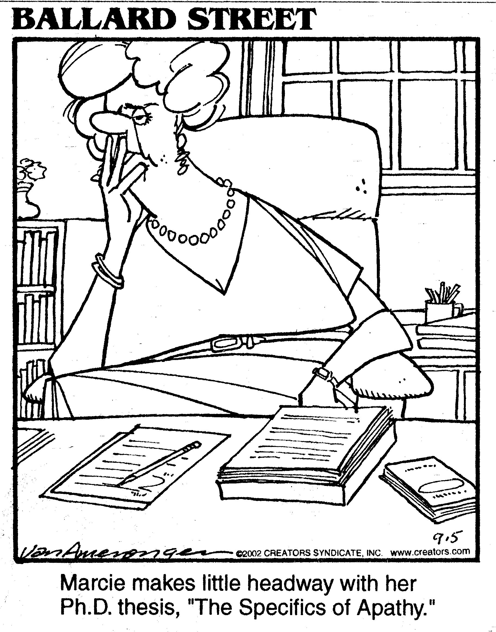
Marcie makes little headway with her Ph.D. thesis, “The Specifics of Apathy.”

Slide 18
Differences Between Quantitative and Qualitative Research

Slide 19
It is not just numbers…
Sometimes qualitative research includes lots of numbers too.

Slide 20
Here is the big difference…
Quantitative research is designed so that the conclusion is the only answer that can follow from the collected data. You collected only the data necessary to achieve that end.
Qualitative research is designed so that the conclusion is probably the best answer that follows from the collected data. You keep collecting as much data as it takes to achieve that end.

Slide 21
In the world of formal logic these two approaches are called deductive (what we are calling quantitative) and inductive (what we are calling qualitative.
Read Eshleman

Slide 22
Validity
When is research valid?

Slide 23
What does valid mean?
the quality of being logically or factually sound; soundness or cogency. (Oxford Dictionary)

Slide 24
Deductive Arguments Arguing from a true premise (general) to the specific
If a teacher uses the Reading First curriculum, student comprehension scores will go up.
The teacher used Reading First.
The student scores are higher.
If the premises are true this is a sound argument.

Slide 25
Inductive Arguments Reasoning from the specific to the general
The most successful teacher in the district uses Reading First. Reading First is the best curriculum. (authority)
Students in three classes experienced Reading First curriculum. Their scores were high. Reading First is the best curriculum (evidence)
When strong evidence is provided it is a cogent argument.

Slide 26
What does valid mean?
To a logician a valid argument is one in which the premises guarantee the truth of the conclusions.
That means they are always deductive.

Slide 27
What does cogent mean?
To a logician a cogent argument is one in which the evidence suggests that the conclusions are probably true.
That means they are always inductive.

Slide 28
Research Comparison

Slide 29
Does this mean that qualitative research is not valid?
Let’s build a cogent argument one way or the other.

Slide 30
What does valid mean?
the quality of being logically or factually sound; soundness or cogency. (Oxford Dictionary)

Slide 31
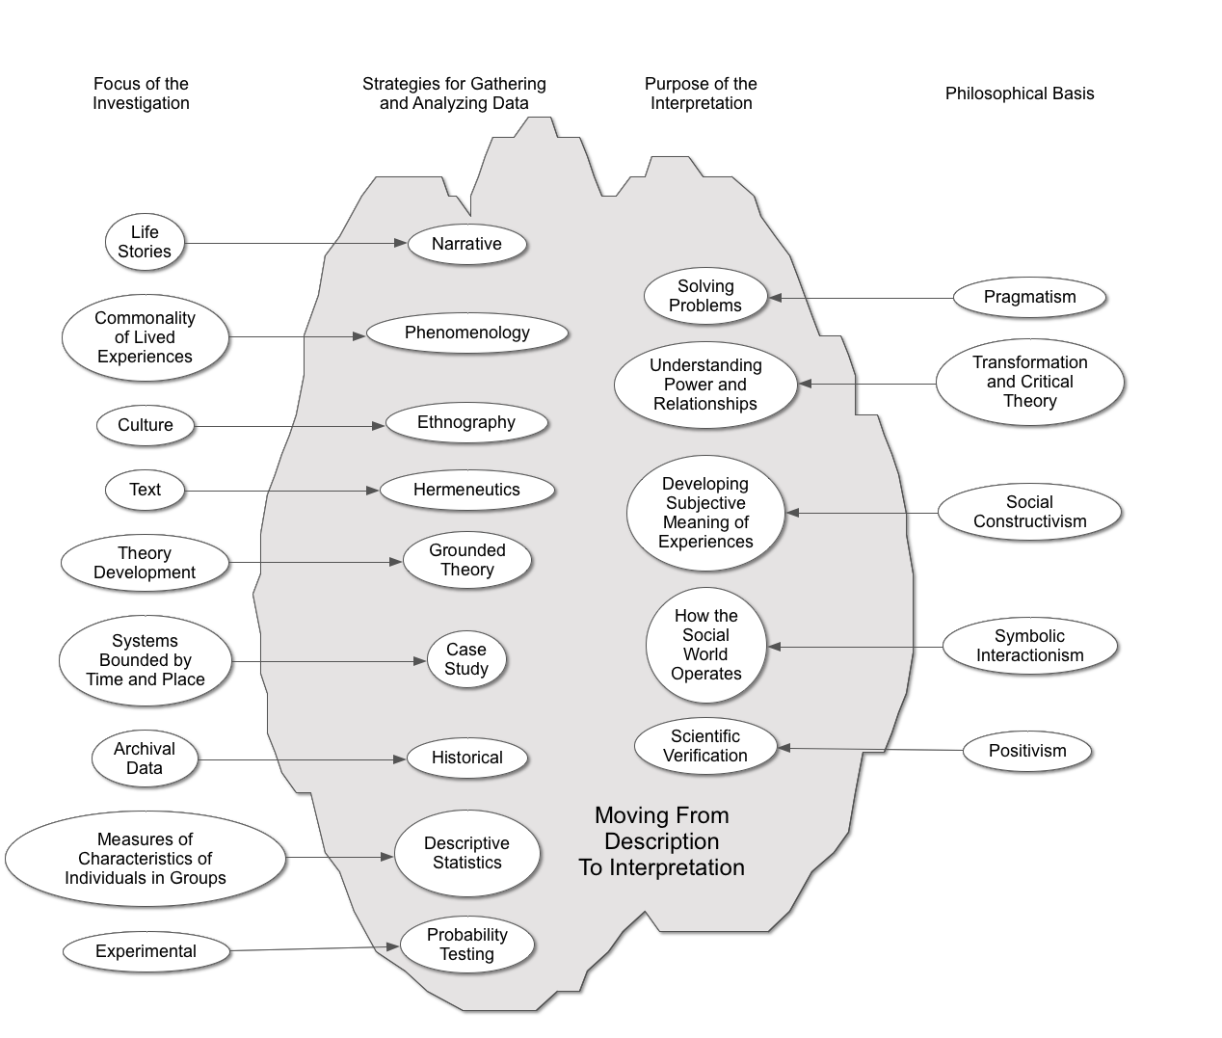

Slide 32
Quantitative Research
Quantitative research is based on the collection and analysis of numerical data.
The data come from measuring characteristics of individuals in groups.

Slide 33
Quantitative Research
For studies in which groups will be compared statistically the general form of a quantitative question is:
What are the comparisons of characteristics of groups based on an intervention?
[group; characteristics to be compared; intervention]
Eventually you will talk about this as group; dependent variable; independent variable.

Slide 34
Qualitative Research
Qualitative, interpretive research is useful for describing or answering questions about particular, localized occurrences or contexts and the perspectives of a particular group toward events, beliefs, or practices.

Slide 35
Qualitative Questions
The general form of qualitative questions is:
What are the patterns and perspectives of a group, about something, in a setting?
[group; setting; topic]
How did teachers in a single rural school district integrate service learning into the elementary curriculum?

Slide 36
Examining Purpose Statements

Slide 37
Writing Purpose Statements
Write examples of your purpose statement in qualitative form.
Begin each statement with the phrase The purpose of this study is ….
Identify the appropriate basic elements of each question.
What are the patterns and perspectives of a group, about something, in a setting?
[group; setting; topic]
Discuss the following questions with your partner:
Is the question clear and understandable?
Are all of the necessary elements present?
Do the elements state what you want to know (is the question precise enough)?
When you listen to someone else’s question does it seem like a good research project—why or why not?

